Slide 1
20MEC521J Fundamentals of Robotic systems Unit I

Slide 2
Unit I
1 | Introduction to Robotics, History - Developments in Robotics
2 | Robot anatomy, Definition and law of robotics
3 | Terminology of Robotics, Accuracy and repeatability, dexterity, compliance
4 | RCC device of Robotics-Simple problems
5 | Specifications of Robot-Speed of Robot- Robot joints and links
6 | Robot Drive Systems-Hydraulic, Pneumatic and Electric system.
7 | Mechanical grippers-Slider crank mechanism, Screw type
8 | Rotary actuators, cam type-Magnetic grippers- Vacuum grippers
9 | Gripper force analysis, Gripper selection and design

Slide 3
Definition (RIA – Robot institute of america)
“ A reprogrammable, multifunctional manipulator designed to move material, parts, tools, or specialized devices through various programmed motions for the performance of a variety of tasks”

Slide 4
Definition – (International Organization for Standardization -ISO):
“An automatically controlled, reprogrammable, multipurpose manipulator programmable in three or more axes, which can be either fixed in place or mobile for use in industrial automation applications”

Slide 5
To qualify as a robot, a machine must be able to:
1) Sensing and perception: get information from its surroundings
2) Carry out different tasks: Locomotion or manipulation, do something physical–such as move or manipulate objects
3) Re-programmable: can do different things
4) Function autonomously and/or interact with human beings

Slide 6
Three Laws of Robotics
FIRST LAW: Do not harm human being
A robot must not harm a human being, or, through inaction, allow a human being to come to harm.
SECOND LAW: Obey human being
A robot must always obey the orders given it by human beings except where such orders would conflict with the First Law.
THIRD LAW: Protects itself from harm
A robot must protect its own existence as long as such protection does not conflict with the First or Second Law.

Slide 7
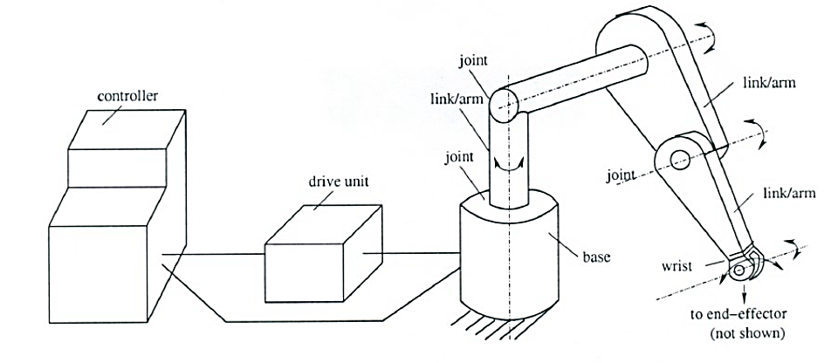
Components of robotic system
Various Components : 1.Base 2.Links and Joints 3.End-effector / gripper 4.Wrist 5.Drive / Actuator 6.Controller 7.Sensors

Slide 8
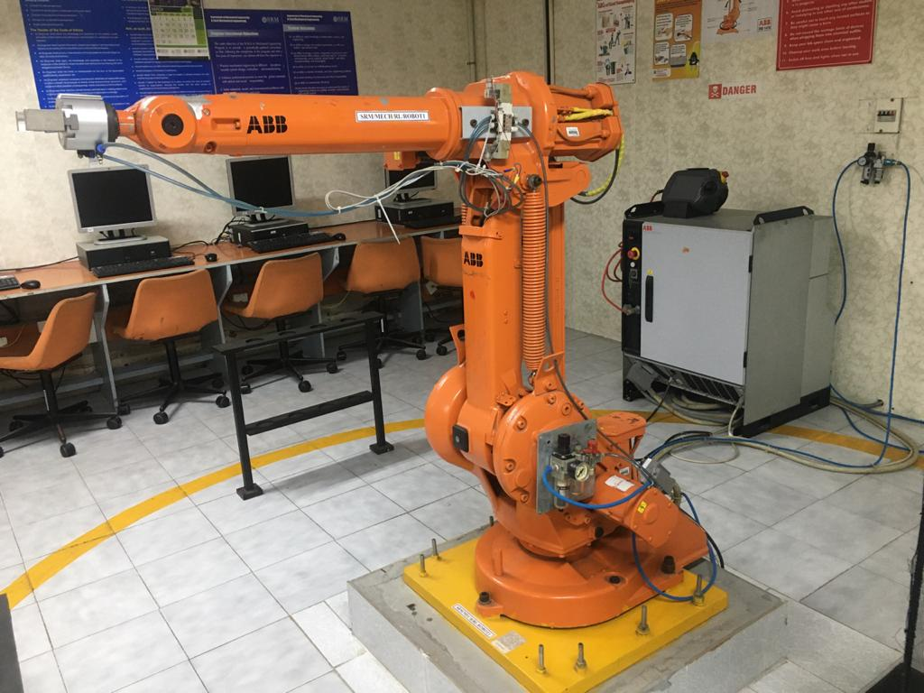
Serial Manipulator

Slide 9
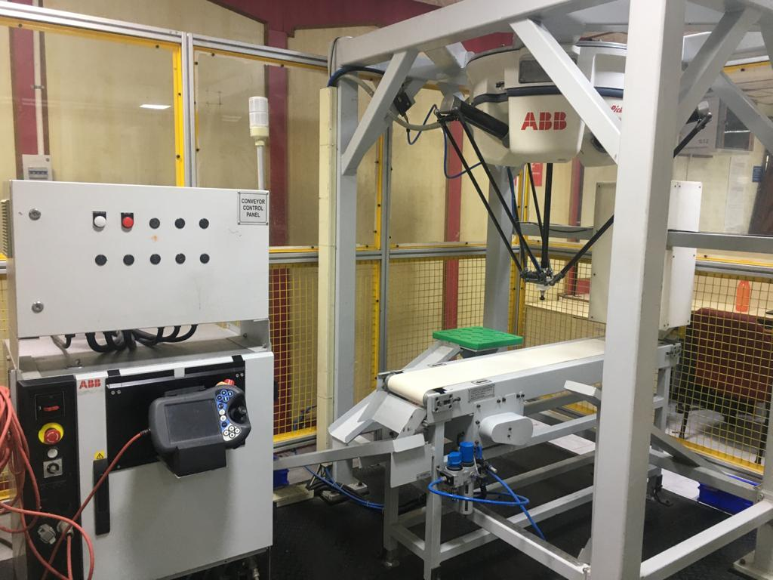
Parallel Manipulator

Slide 10
Robot Anatomy
Manipulator consists of joints and links
Joints provide relative motion
Links are rigid members between joints
Various joint types: linear and rotary
Each joint provides a “degree-of-freedom”
Most robots possess five or six degrees-of-freedom
Robot manipulator consists of two sections:
Body-and-arm – for positioning of objects in the robot's work volume
Wrist assembly – for orientation of objects

Slide 11
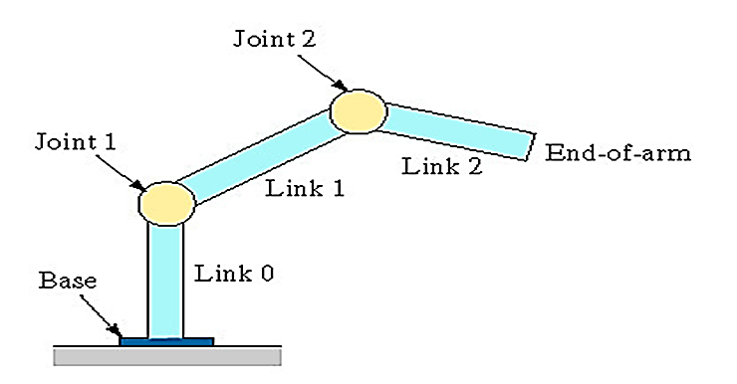
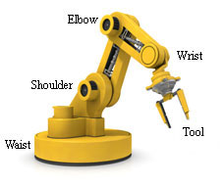
Robot Anatomy

Slide 12
Degrees of freedom (DOF)
DOF / Connectivity is defined as one of the variable required to define the motion of the body in space.
Degree of freedom of a system depends on the number of variable or coordinates that are needed to describe its position.
Each joint in a robotic system gives the robot one degree of freedom.

Slide 13
The Robotic Joints
A robot joint is a mechanism that permits relative movement between parts of a robot arm.
The joints of a robot are designed to enable the robot to move its end - effector along a path from one position to another as desired.

Slide 14
The Robotic Joints
These degrees of freedom, independently or in combination with others, define the complete motion of the end-effector.
These motions are accomplished by movements of individual joints of the robot arm. The joint movements are basically the same as relative motion of adjoining links.
Depending on the nature of this relative motion, the joints are classified as prismatic or revolute.

Slide 15
The Robotic Joints
Prismatic joints (L) are also known as sliding as well as linear joints.
They are called prismatic because the cross section of the joint is considered as a generalized prism. They permit links to move in a linear relationship.

Slide 16
The Robotic Joints
Revolute joints permit only angular motion between links. Their variations include:
Rotational joint (R)
Twisting joint (T)
Revolving joint (V)

Slide 17
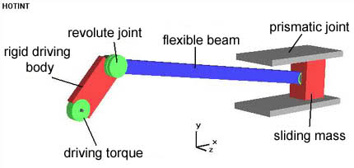

Slide 18
Mechanical Joints for Robots
Translational motion - Prismatic joints
Linear joint (type L)
Orthogonal joint (type O)
Rotary motion - Revolute joints
Rotational joint (type R)
Twisting joint (type T)
Revolving joint (type V)

Slide 19

Translational Motion Joints
Linear joint
Type L joint; the relative movement between the input link and the output link is a translational sliding motion, with the axes of the two links parallel.

Slide 20
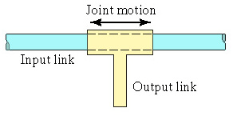
Translational Motion Joints
Orthogonal joint
Type O joint; the relative movement between the input link and the output link is a translational sliding motion, but the output link is perpendicular to the input link.

Slide 21
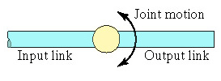
Rotary motion
Rotational joint
Type R joint; this provides rotational relative motion, with the axis of rotation perpendicular to the axes of the input and output links.

Slide 22
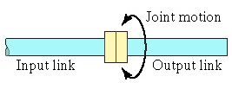
Rotary motion
Twisting joint
Type T joint; this provides rotary motion, but the axis of rotation is parallel to the axes of the two links.

Slide 23
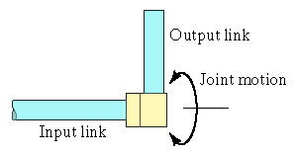
Rotary motion
Revolving joint
Type V joint; the axis of the input link is parallel to the axis of rotation of the joint, and the axis of the output link is perpendicular to the axis of rotation.

Slide 24
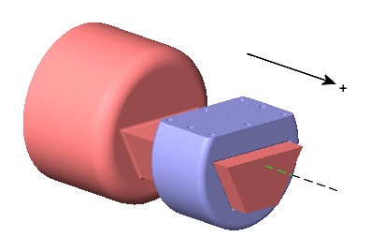
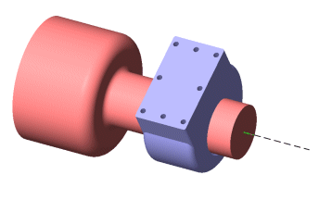
Constraints???

Slide 25
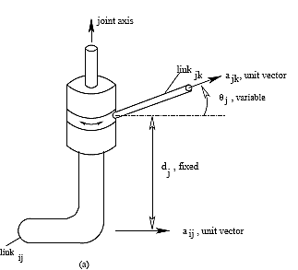
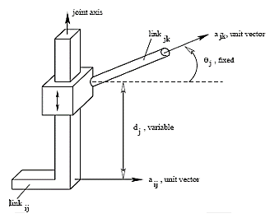
DOF??
1 DOF - Rovolute
1 DOF - Prismatic

Slide 26
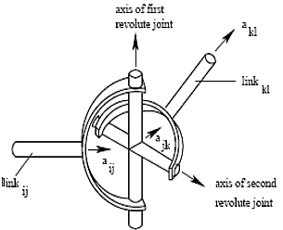
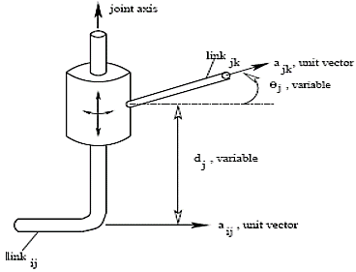
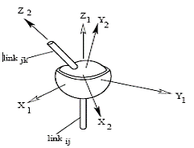
2 DOF – Hooke joint
2 DOF – Cylindrical joint
3 DOF – Ball and Socket joint

Slide 27
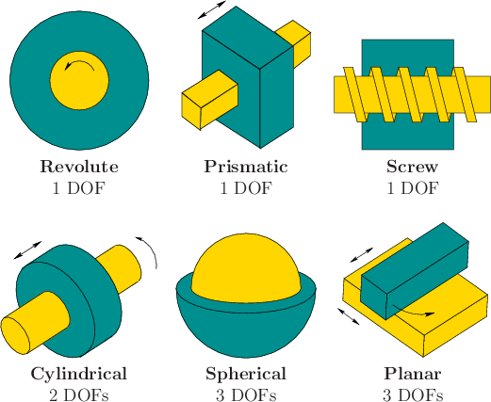

Slide 28
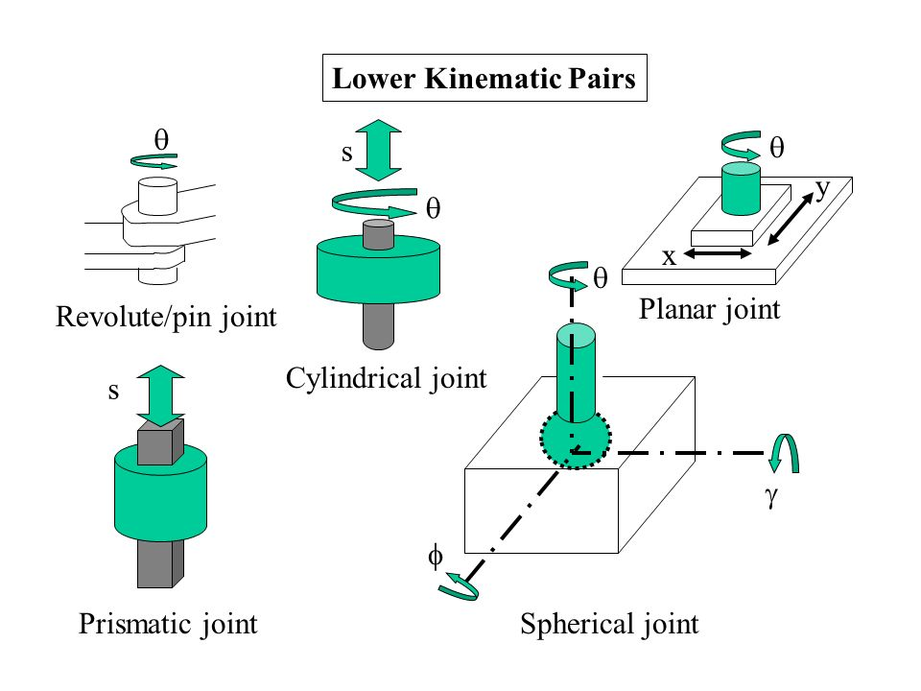
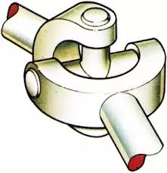

Slide 29
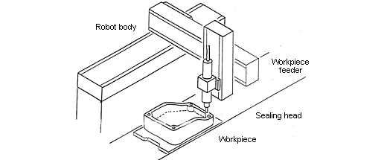
Name the joints? DOF?

Slide 30
DOF
A point in 2-D:
A point in 3-D space:
A rigid body in 3-D:
Spatial Manipulator:
Planar Manipulator:
2 DOF
3 DOF
6 DOF
6 DOF
3 DOF

Slide 31
Redundant Manipulator:
Either a Spatial Manipulator with more than 6 dof or a Planar Manipulator with more than 3 dof
Under-actuated Manipulator
Either a Spatial Manipulator with less than 6 dof or a Planar Manipulator with less than 3 dof

Slide 32
Exercise
Draw the following configurations
LRL - ORO
RRL - RRO
TRL
LVL - OVO

Slide 33
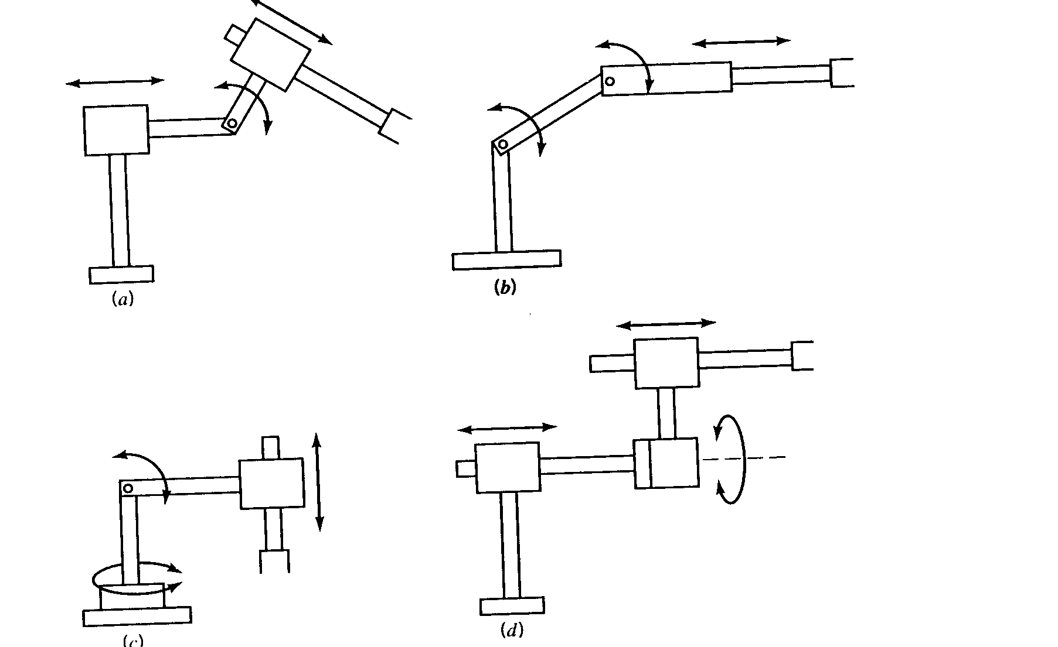

Slide 34
Sketch following manipulator configurations
(a) TRT:R, (b) TVR:TR, (c) RR:T.
Solution:

Slide 35
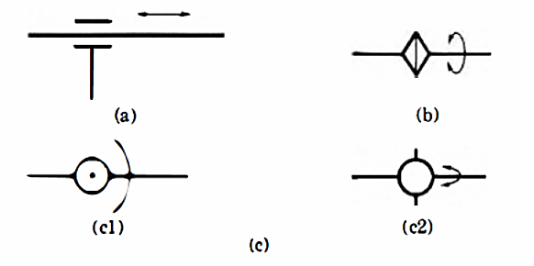
Joint representations
Symbols of joints (arrows show direction of motion). (a) Prismatic joint. (b) Revolute joint
1. (c) Revolute joint 2. (cl) Up-and-down rotation. (c2) Back-and-forth rotation.

Slide 36
Can you name the common coordinate systems in robots????
Cartesian coordinate system
Cylindrical coordinate system
Polar or Spherical coordinate system
Revolute coordinate system

Slide 37
Robot Body-and-Arm Configurations
Five common body-and-arm configurations for industrial robots:
Polar coordinate body-and-arm assembly
Cylindrical body-and-arm assembly
Cartesian coordinate body-and-arm assembly
Jointed-arm body-and-arm assembly
Selective Compliance Assembly Robot Arm (SCARA)
Function of body-and-arm assembly is to position an end effector (e.g., gripper, tool) in space

Slide 38
Work volume (Work envelope)
Volume in which the robot is able to work.
The work volume is determined by the following physical characteristics of the robot:
The robots physical configuration
The size of the body, arm, and wrist components
The limits of the robots joint movements.
Dextrous Workspace
It is the volume of space, which the robot’s end-effector can reach with various orientations
Reachable Workspace
It is the volume of space that the end-effector can reach with one orientation

Slide 39
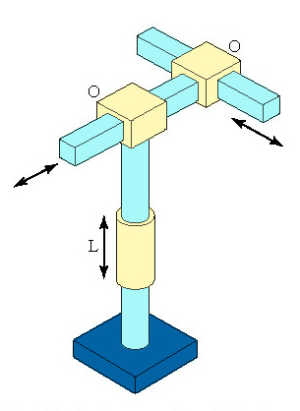
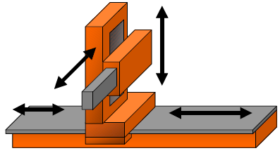
ROBOT CLASSIFICATION
Cartesian Configuration:
Robots with Cartesian configurations consists of links connected by linear joints (L). Gantry robots are Cartesian robots (LLL).
Also known as rectilinear robot and x-y-z robot. Consists of three sliding joints, two of which orthogonal (O joint).

Slide 40
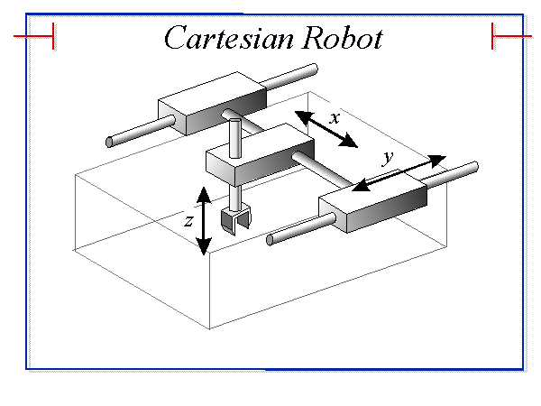
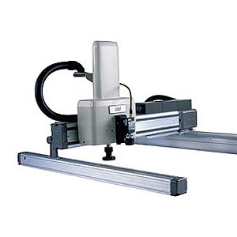
Cartesian Coordinate Body-and-Arm Assembly
A robot with 3 prismatic joints – the axes consistent with a Cartesian coordinate system.
Commonly used for:
pick and place work
assembly operations
handling machine tools
arc welding

Slide 41
Advantages
Linear motion in three dimension
Simple kinematic model
Rigid structure
Higher repeatability and accuracy
High lift-carrying capacity as it doesn’t vary at different locations in work volume
Easily visualize
Can increase work volume easily
Inexpensive pneumatic drive can be used for P&P operation
Notes:
41
29 October 2020
Cont.

Slide 42
Disadvantages
requires a large volume to operate in
work space is smaller than robot volume
unable to reach areas under objects
must be covered from dust
Applications
Assembly
Palletizing and loading-unloading machine tools,
Handling
Welding
Notes:
42
29 October 2020
Cont.

Slide 43
Cartesian Robot - Work Envelope

Slide 44
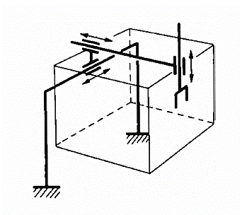
Can you draw Orthogonal-coordinate type robot? (Symbolic representation)

Slide 45
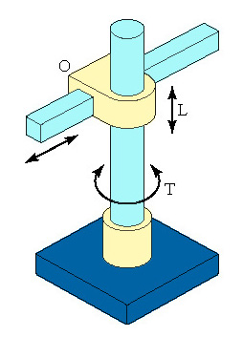
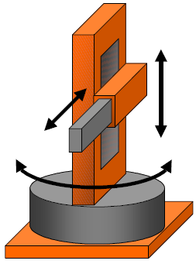
Cylindrical coordinate
Consists of a vertical column, relative to which an arm assembly is moved up or down. The arm can be moved in and out relative to the axis of the column. Common configuration is to use a T joint to rotate the column about its axis. An L joint is used to move the arm assembly vertically along the column, while an O joint is used to achieve radial movement of the arm.

Slide 46
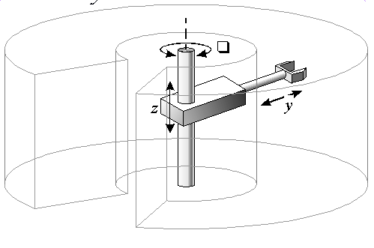
Advantages
Simple kinematic model
Rigid structure & high lift-carrying capacity
Easily visualize
Very powerful when hydraulic drives used
Disadvantages
Restricted work space
Lower repeatability and accuracy
Require more sophisticated control
Applications
Palletizing, Loading and unloading
Material transfer, foundry and forging

Slide 47
Cylindrical Robot - Work Envelope

Slide 48
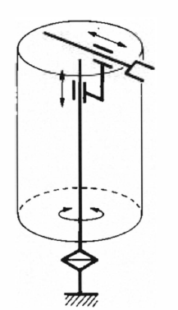
Can you draw Cylindrical-coordinate type robot? (Symbolic representation)

Slide 49
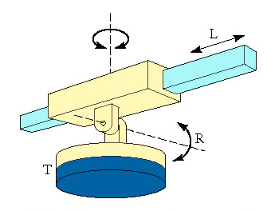
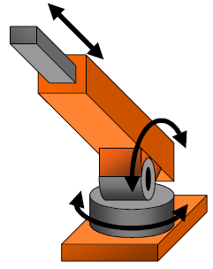
Polar Coordinate Body-and-Arm Assembly
Notation TRL:
Consists of a sliding arm (L joint) actuated relative to the body, which can rotate about both a vertical axis (T joint) and horizontal axis (R joint)
Polar robots have a work space of spherical shape. Generally, the arm is connected to the base with a twisting (T) joint and rotatory (R) and linear (L) joints follow.

Slide 50
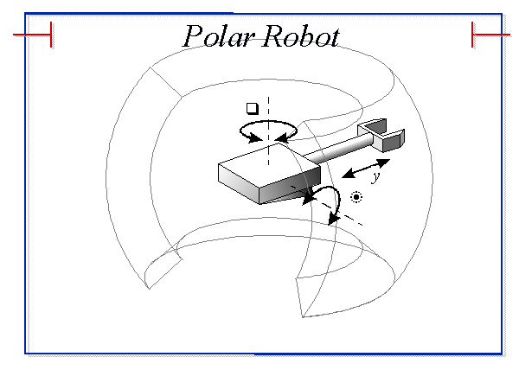
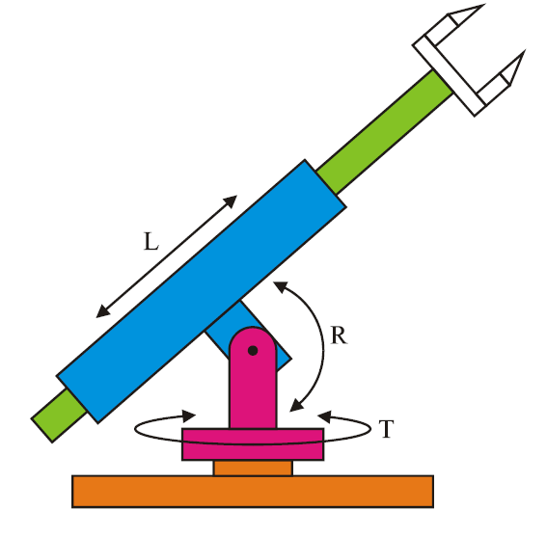
Spherical/Polar Robots
A robot with 1 prismatic joint and 2 rotary joints – the axes consistent with a polar coordinate system.
Commonly used for:
handling at die casting or fettling machines
handling machine tools
arc/spot welding

Slide 51
Advantages
Covers a large volume
Can bend down to pick objects up off the floor
Higher reach ability
Disadvantages
Complex kinematic model
Difficult to visualize
Applications
Palletizing
Handling of heavy loads e.g. casting, forging

Slide 52
Spherical Robot - Work Envelope

Slide 53
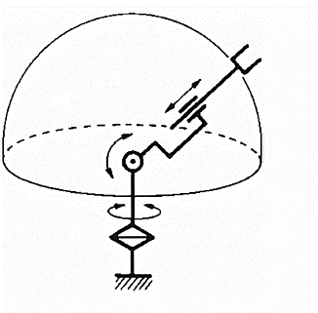
Can you draw Polar-coordinate type robot? (Symbolic representation)

Slide 54
ROBOT CLASSIFICATION
The designation of the arm for this configuration can be TRL or TRR.
Robots with the designation TRL are also called spherical robots. Those with the designation TRR are also called articulated robots. An articulated robot more closely resembles the human arm.

Slide 55
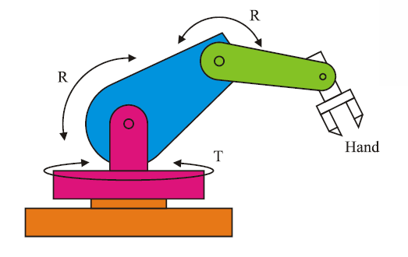
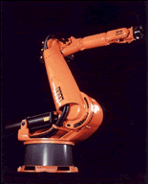
Articulated Robots
A robot with at least 3 rotary joints.
Commonly used for:
assembly operations
welding
weld sealing
spray painting
handling at die casting or fettling machines

Slide 56
Articulated Robots
Advantages:
all rotary joints allows for maximum flexibility
any point in total volume can be reached.
all joints can be sealed from the environment.
Disadvantages:
extremely difficult to visualize, control, and program.
restricted volume coverage.
low accuracy

Slide 57
Joint-arm Configuration
The jointed-arm is a combination of cylindrical and articulated configurations. The arm of the robot is connected to the base with a twisting joint. The links in the arm are connected by rotatory joints. Many commercially available robots have this configuration.
General configuration of a human arm, this consists of a vertical column that swivels about the base using a T joint. At the top of the column is a shoulder joint (an R joint), output to an elbow joint (another R joint).

Slide 58
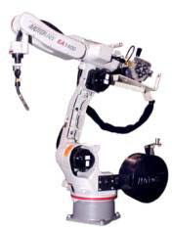
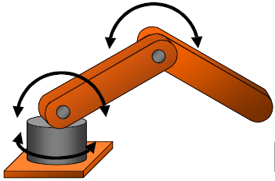
Joint-arm Configuration

Slide 59
Advantages
Maximum flexibility
Cover large space relative to work volume objects up off the floor
Suits electric motors
Higher reach ability
Disadvantages
Complex kinematic model
Difficult to visualize
Structure not rigid at full reach
Applications
Spot welding, Arc welding

Slide 60
Jointed Arm - Work envelope

Slide 61
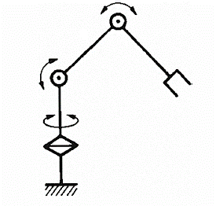
Can you draw Jointed Arm type robot? (Symbolic representation)

Slide 62
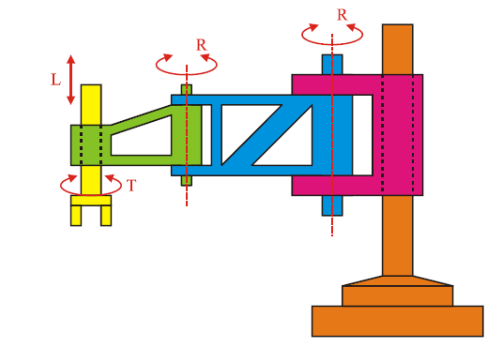
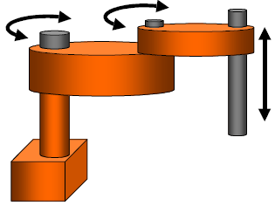
SCARA Robots
(Selective Compliance Articulated Robot Arm)
Selective Compliance Assembly Robot Arm. Similar in construction to the jointer-arm robot, except that the shoulder and elbow rotational axes are vertical, which means that the arm is very rigid in the vertical direction, but compliant in the horizontal direction.

Slide 63
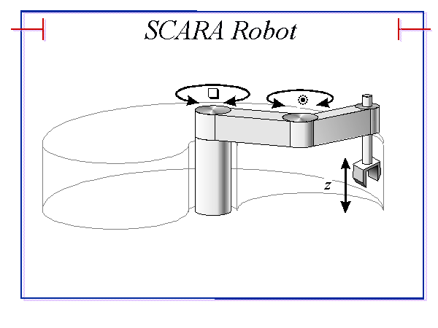
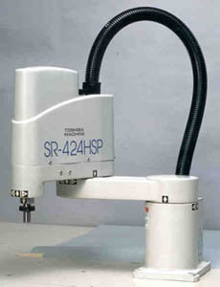
SCARA Robots
(Selective Compliance Articulated Robot Arm)
A robot with at least 2 parallel rotary joints.
Commonly used for:
pick and place work
assembly operations

Slide 64
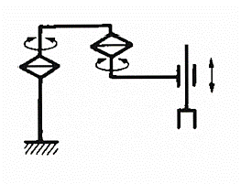
Can you draw SCARA type robot? (Symbolic representation)

Slide 65
Configuration | Advantages | Disadvantages
Cartesian coordinates | 3 linear axes, easy to visualize, rigid structure, easy to program | Can only reach front of itself, requires large floor space, axes hard to seal
Cylindrical coordinates | 2 linear axes +1 rotating, can reach all around itself, reach and height axes rigid, rotational axis easy to seal | Can’t reach above itself, base rotation axis as less rigid, linear axes is hard to seal, won’t reach around obstacles
SCARA coordinates | 1 linear + 2 rotating axes, height axis is rigid, large work area for floor space | 2 ways to reach point, difficult to program off-line, highly complex arm
Spherical coordinates | 1 linear + 2 rotating axes, long horizontal reach | Can’t reach around obstacles, short vertical reach
Revolute coordinates | 3 rotating axes can reach above or below obstacles, largest work area for least floor space | Difficult to program off-line, 2 or 4 ways to reach a point, most complex manipulator

Slide 66
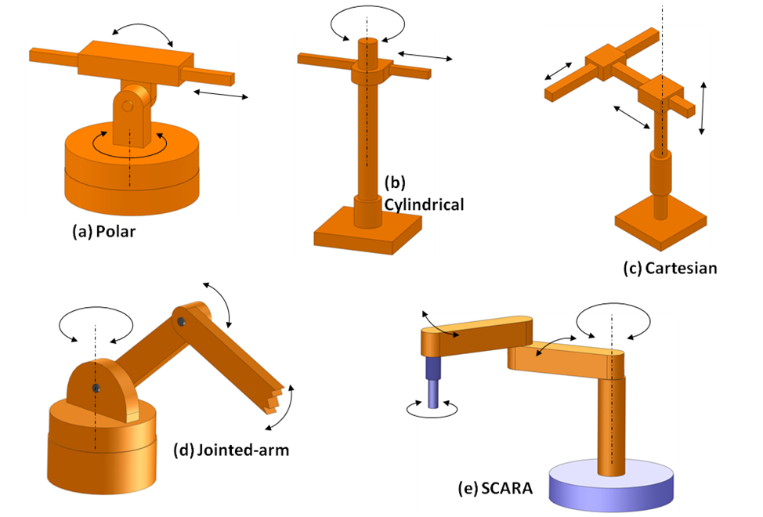

Slide 67
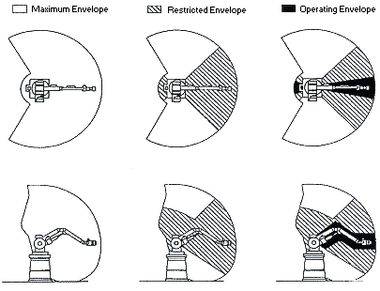
Working Envelope

Slide 68
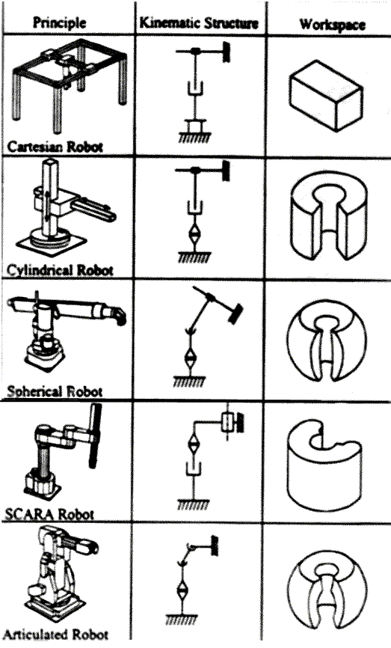


Slide 69

Wrist Configurations
Wrist assembly is attached to end-of-arm
End effector is attached to wrist assembly
Function of wrist assembly is to orient end effector
Body-and-arm determines global position of end effector
Two or three degrees of freedom:
Roll
Pitch
Yaw

Slide 70
Six basic robot motions are ???
Radial traverse: Involve the extension and retraction (in or out movement) of the arm relative to the base
Vertical traverse: Provide up-and-down motion of the arm
Rotational traverse: Rotation of the arm about vertical axis such as left-and-right swivel of the robot arm about a base
Wrist Pitch/Bend: Provide up-and-down rotation to the wrist
Wrist Yaw: Involve right-and-left rotation of the wrist
Wrist Roll/Swivel: Is the rotation of the wrist about the arm axis

Slide 71


Slide 72

Spatial Resolution
Notes:
72
29 October 2020
Cont.

Slide 73
Spatial Resolution
Defined as smallest increment of movement into which the robot can divide its work volume
Depends on two factors: system’s control resolution and the robot’s mechanical inaccuracies
Control resolution is determined by robot’s position control system and its feedback measurement system
Ability to divide total range of movement for the particular joint into individual increments that can be addressed in the controller
The increments are sometimes referred to as “ addressable points”
Notes:
73
29 October 2020
Cont.

Slide 74
Spatial Resolution
Joint range depends on the bit storage capacity in the control memory
Number of increments for a axis is given by
Number of Increments = 2^{n}
n = the number of bits in the control memory
Have a control resolution for each joint in case of several DOF
Total control resolution depend on the wrist motions as well as the body and arm motions
Notes:
74
29 October 2020
Cont.

Slide 75
Spatial Resolution
Mechanical inaccuracies come from elastic deflection in the structure elements, gear backlash, stretching of pulley cords, leakage of hydraulic fluids and other imperfections in the mechanical system
Also affected by load being handled, the speed of arm moving, condition of maintenance of robot
Notes:
75
29 October 2020
Cont.

Slide 76
Accuracy
Ability to position its wrist end at a desired target point within the work volume
Depends on spatial resolution means how closely the robot can define the control increments
One half of the control resolution by ignoring the mechanical inaccuracies
Notes:
76
29 October 2020
Cont.

Slide 77


Notes:
77
29 October 2020
Cont.

Slide 78
Repeatability
Ability to position its wrist at a point in space that had been taught
Accuracy relates to its capacity to be programmed to achieve a given target point
Programmed point and target point may be different due to limitations of resolution
Repeatability refers to ability to return to the programmed point when commanded to do so
Notes:
78
29 October 2020
Cont.

Slide 79


Slide 80
Robot drive systems

Slide 81
Drive Systems
Capacity to move robot’s body, arm and wrist
Determine speed of the arm movements, strength of the robot & dynamic performance
Type of applications that the robot can accomplish
Powered by three types of drive systems:
Hydraulic
Pneumatic
Electric
Notes:
81
29 October 2020
Cont.

Slide 82

Notes:
82
29 October 2020
Cont.

Slide 83
Hydraulic Drive
Linear piston or rotary vane types.
High power-to-weight ratio suitable for high loads at moderate speeds.
Easily controllable due to high stiffness of hydraulic system.
Require high energy storage systems such as pumps and accumulators.
Susceptible to leakage, which may reduce efficiency.
Require filtration.
Air entrapment and cavitation may cause difficulties.
Servo valves controlling the fluid flow must be placed close to the actuators to increase the stiffness of the control system.
Suitable for harsh environments caused by dust, dirt, and moisture.

Slide 84
Hydraulic Drive
Associated with large robot
Provide greater speed & strength
Add floor space
Leakage of oil
Provide either rotational or linear motions
Applications such as:
Spray coating robot
Heavy part loading robot
Material handling robot
Translatory motions in cartesian robot
Gripper mechanism
Notes:
84
29 October 2020
Cont.

Slide 85

Hydraulic Drive..
Notes:
85
29 October 2020
Cont.

Slide 86
Pneumatic actuators
Used in inexpensive manipulators with low load-carrying capacity.
Usually require mechanical stops for accurate positioning in non-servo control.
Single- and double-acting piston or rotary vane types are commonly used.
Inherently lightweight at moderate operating pressures.
Limited by low efficiency at reduced loads and low stiffness due to compressibility.

Slide 87
Pneumatic Drive
Reserved for smaller robot
Limited to “pick-and-place” operations with fast cycles
Drift under load as air is compressible
Provide either rotational or linear motions
Simple and low cost components
Used to open and close gripper
Notes:
87
29 October 2020
Cont.

Slide 88
Electric motors
Provide a variety of power systems.
Easier to control.
May not be as responsive as hydraulic systems and stiffer than pneumatic systems with low pressure.
Normally require speed reducers, which introduce inefficiency and error in operation.
Variety of types such as permanent magnet DC motors, printedcircuit motors , stepping motors, and direct drives.

Slide 89
Electric Drive
Rotor, stator, brush and commutator assembly
Rotor has got windings of armature and stator has got magnets
The brush and the commutator assembly switch the current in armature windings
The most commonly used are DC servomotors, AC servomotors and stepper motors
Notes:
89
29 October 2020
Cont.

Slide 90

Robot Controls with Hydraulic, Pneumatic, and Electric Systems

Slide 91

Speed of motion and Load carrying capacity
Speed depends on the following factors
The accuracy with which the end effector must be positioned
The weight of the object being manipulated
The distance to be moved

Slide 92

Speed of motion and Load carrying capacity
Can you tell me how much load you can carry??
The load carrying capacity should be specified under the condition that the robots arm is in its weakest position.

Slide 93


End effectors

Slide 94
Classification
Two categories of end effectors are
Grippers
Tools
According to the types of grasping, the end effectors are grouped in to
Mechanical fingers
Special tools
Universal fingers

Slide 95
Tools are used in applications where the robot must perform some processing operation on the part. Examples of the tools are:
Spot welding gun.
Arc welding tool.
Spray painting gun.
Rotating spindle for drilling, grinding, and so forth.
Assembly tool (e.g. automatic screw driver)
Heating torch.

Slide 96
Types of grippers
Mechanical grippers
Hooking or lifting grippers
Grippers for scooping or ladling powders or molten metals or plastics
Vacuum cups (Negative Pressure)
Magnetic grippers
Adhesive
Electrostatic grippers

Slide 97
Mechanical grippers
It uses mechanical fingers actuated by a mechanism to grip an object.
Various mechanisms used in mechanical grippers are
Linkage
Gear and rack
Cam
Screw
Cable and pulley, etc.,
The grippers can actuate the opening or closing of the fingers by
Pivoting or swinging movement
Linear or translational movement

Slide 98
Mechanical grippers
The function of the gripper mechanism is to translate some form of power input into the grasping action of the fingers against the part.
There are two ways of constraining the part in the gripper.
By physical constriction of the part within the fingers – this is usually accomplished by the contacting surfaces of the fingers to ne in the approximate shape of the work geometry
By friction between the fingers and the workpart – the fingers must apply a force that is sufficient for friction to retain the part against gravity, acceleration, and any other force that might arise during the holding portion of the work cycle.

Slide 99


By friction between the fingers and the workpart
By physical constriction of the part within the fingers

Slide 100
The part might slip out of the gripper if the applied force is insufficient.
To resist this slippage, the gripper must be designed to exert a force that depends on the weight of the object, the co-efficient of friction between the part surface and the finger, the acceleration of the part and the orientation between the direction of motion during acceleration and the direction of fingers.

Slide 101


Types of mechanical actuation - Pivoting or swinging movement
Linkage actuation:

Slide 102


Rack and Pinion actuation:
A rack actuated by a hydraulic / pneumatic cylinder operates two pivoted pinions.
The fingers attached to the racks open and close to grab and release the object.

Slide 103

CAM actuation:
A cam attached to a cylinder moves to and fro.
Spring loaded followers moves on the cam profile.
The finger pads attached to the pivoted liver connected to the followers open and close to release and grab the object

Slide 104

Screw actuation:
A threaded block engages with a screw moves forward and backward, the fingers attached to levers connected to the threaded block by a hinged joint, open and close providing releasing and gripping action.
The screw is rotated by a motor through reduction box.

Slide 105

Types of mechanical actuation –translational movement

Slide 106

Gear and Rack Grippers
movement of input due to gear motion which makes connecting links to go in motion to make gripping action at the output link.
http://sra.vjti.info/knowledgebase/posts-on-a-roll-1/gripper-mechanisms

Slide 107

Three Fingered Grippers
http://sra.vjti.info/knowledgebase/posts-on-a-roll-1/gripper-mechanisms

Slide 108

Vacuum Grippers link
for non-ferrous components with flat and smooth surfaces, grippers can be built using standard vacuum cups or pads made of rubber-like materials. Not suitable for components with curved surfaces or with holes.
http://sra.vjti.info/knowledgebase/posts-on-a-roll-1/gripper-mechanisms

Slide 109

Magnetic Gripper
gripper
http://sra.vjti.info/knowledgebase/posts-on-a-roll-1/gripper-mechanisms

Slide 110

GRIPPER FORCE ANALYSIS
The fig. shows the linkage mechanism and dimensions of a gripper used to handle a workpart for a machining operation. Suppose it has been determine that the gripper force is to be 25 N. What is required is to compute the actuating force to deliver this force of 25 N.

Slide 111



Due to symmetry of the gripper consider only one half of the mechanism.
Moments :-
25(4cos 15°) = Fsin 45°(1.5cos15°) + Fcos45°(1.5sin15°)
96.6 = F(1.0246+0.2745) =1.2991F
F = 74.4 N
The actuation force applied to the plunger to deliver this force of 74.4 N to each finger.
So,
Fa = 2 X 74.4 X cos45°
Fa = 105.2 N

Slide 112

GRIPPER FORCE ANALYSIS

Slide 113




Slide 114



Slide 115



Slide 116



Slide 117


Slide 118

A Cartesian robot has a horizontal reach of 450 mm and a horizontal stroke of 250 mm. What is the maximum limit within which the object placed is not reachable?

Slide 119


Slide 121
CONSIDERATIONS IN GRIPPER SELECTION AND DESIGN
The important factors that determine the required grasping force are:
The weight of the object. Consideration of whether the part can be grasped consistently about its center of mass. If not, an analysis of the possible moments from off-center grasping should be considered.
The speed and acceleration with which the robot arm moves (acceleration and deceleration forces), and the orientational relationship between the direction of movement and the position of the fingers on the object (whether the movement is parallel or perpendicular to the finger surface contacting the part)
Whether physical constriction or friction is used to hold the part.
Coefficient of friction between the object and the gripping fingers.

Slide 122


Slide 123

Gripper design considerations

Slide 124

Gripper design considerations

Slide 125

Selection consideration of gripper

Slide 126
Checklist of factors in the selection and design of grippers
Factor | Consideration
Part to be handled | Weight and size Shape Changes in shape during processing Tolerances on the part size Surface condition, protection of delicate surfaces
Actuation method | Mechanical grasping Vacuum cup Magnet Other methods (adhesives, scoops, etc.)

Slide 127
Checklist of factors in the selection and design of grippers
Factor | Consideration
Power and signal transmission | Pneumatic Electrical Hydraulic Mechanical
Gripper force (mechanical gripper) | Weight of the object Method of holding (physical constriction or friction) Coefficent of firction between fingers and object Speed and acceleration during motion cycle
Positioning problems | Length of finger's Inherent accuracy and repeatability of robot Tolerances on the part size

Slide 128
Checklist of factors in the selection and design of grippers
Factor | Consideration
Service conditions | Number of actuations during lifetime of gripper Replaceabilty of wear components (fingers) Maintenance and serviceability
Operating environment | Heat and temperature Humidity, moisture, dirt, chemicals
Temperature protection | Heat shields Long fingers Forced cooling (compressed air, water cooling, etc.) Use of heat-resistant materials

Slide 129
Checklist of factors in the selection and design of grippers
Factor | Consideration
Fabrication materials | Strength, rigidity, durability Fatigue strength Cost and ease of fabrication Friction properties for finger surfaces Compatibility with operating environment
Other considerations | Use of interchangeable fingers Design standards Mounting connections and interfacing with robot Risk of product design changes and their effect on the gripper design Lead time for design and fabrication Spare parts. maintenance, and service

Slide 130


General architecture of a robotic mechanical system

Slide 131
CLASSIFICATION OF ROBOTICS
■ Robotic Manipulator
■ Wheeled Mobile Robots (WMR)
■ Legged Robots
■ Underwater Robots and Flying Robots
■ Robot Vision
■ Artificial Intelligence
■ Industrial Automation

Slide 132

Industrial Robot Applications

